Slide 1
POSITIONAL ASTRONOMY unit 2

Slide 2
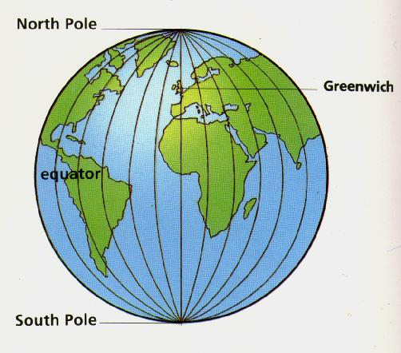
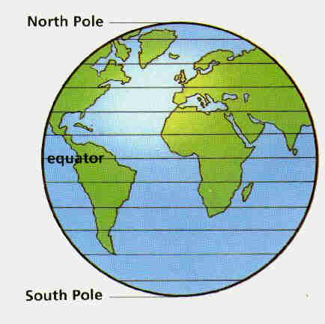
How do we locate places on Earth?
Position in degrees:
  Longitude: connecting the poles, 360º, or 180º E and 180º W
  Latitude: parallel to the equator, 0-90º N and 0-90º S
  A location is the intersection of a longitude and latitude line
0º
90º N
0º
90º S
Our location: 15. 4° N, 73.9° E

Slide 3
The Celestial Sphere
Used to describe the position of a celestial object
The Sun, the Moon and the stars are so far away that we cannot perceive their distances - no depth perception.
Instead, the objects appear to be projected onto a giant, imaginary sphere of arbitrary radius centered on the Earth.
The celestial sphere is fixed to the stars, so it appears to rotate around the Earth as the Earth rotates.
By setting up a coordinate system on this sphere, we can say where to point our telescopes to find an object.
Notes:
Note that stars really are distributed in a 3D space!

Slide 4
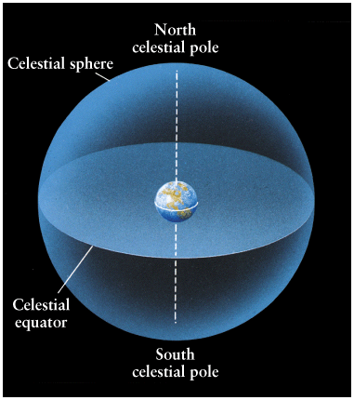
The celestial equator is the projection onto the celestial sphere of the Earth’s equator.
The Earth's poles extend and intersect with the celestial sphere as the North celestial pole and the South celestial pole.
To locate an object, two numbers (in degrees), like longitude and latitude are sufficient.
Notes:
Totally imaginary because the stars are really distributed in a 3D space!

Slide 5
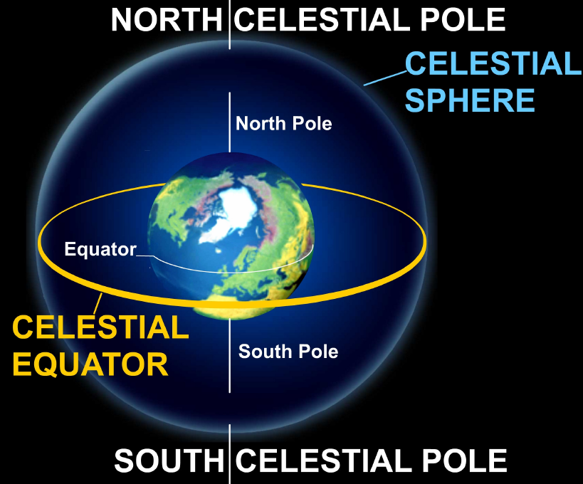
The zenith is the point directly overhead.
The meridian is the north-south circle that passes through the zenith and both celestial poles.
The horizon delimits the portions of the sky we can and can’t see at any given time.
Over the course of a night, the celestial sphere appears to rotate around us.
Notes:
Four cardinal directions: North, south, east and west. The point directly underneath: Nadir (opposite to zenith).

Slide 6

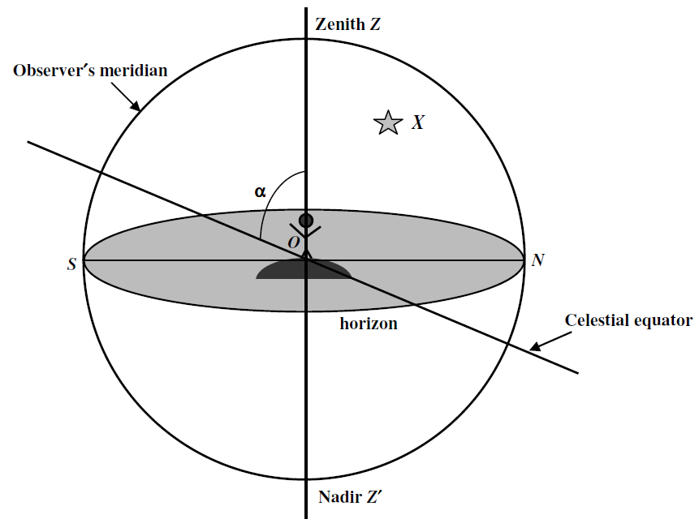

Slide 7
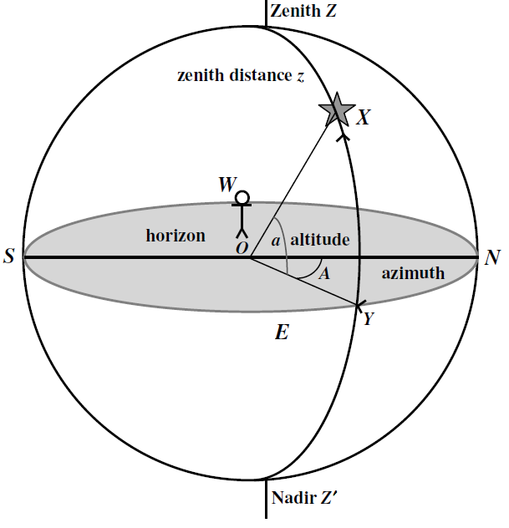
1. The Horizon coordinate system
Altitude
  Angle above the horizon
  0° (horizon) to 90º (zenith)
  The altitude of the north celestial pole equals the observer's latitude on Earth.
Azimuth
  Angle measured eastward along horizon, starting from the north
  0-360º

Slide 8
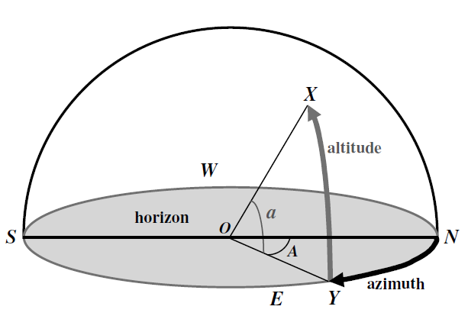

Slide 9
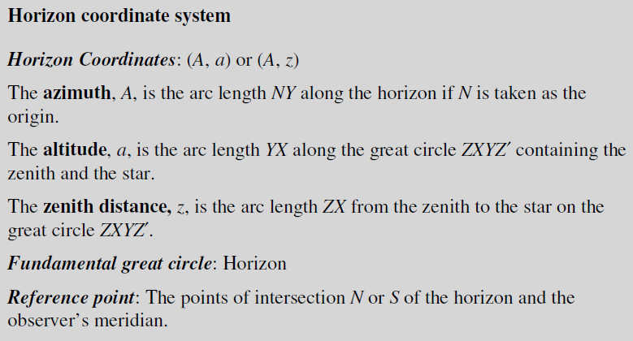

Slide 10
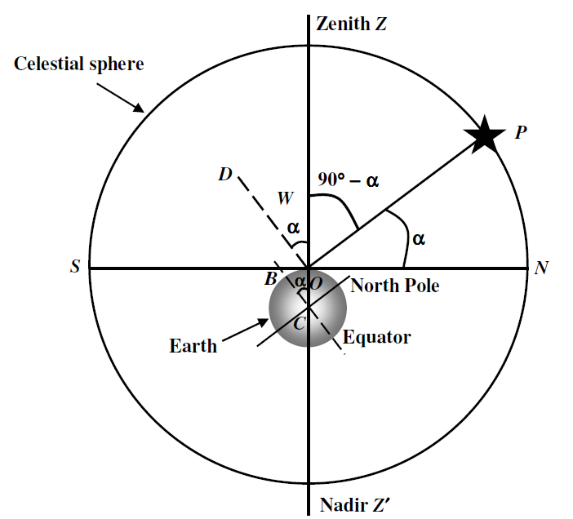
A person/location's latitude is equal to the altitude of Polaris (as long as the location is north of the equator).

Slide 11
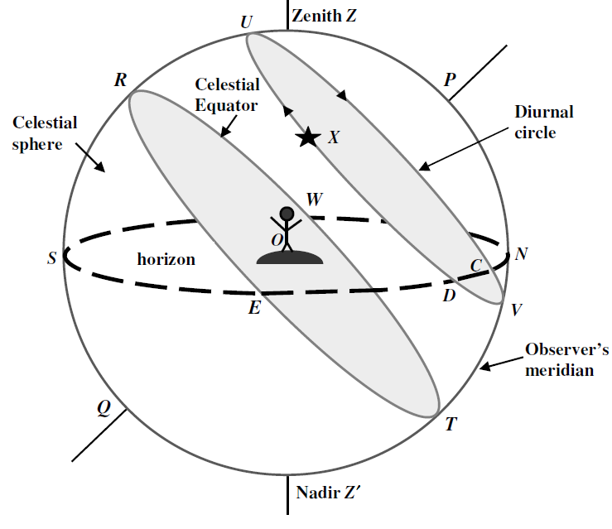
2. The Equatorial coordinate system

Slide 12
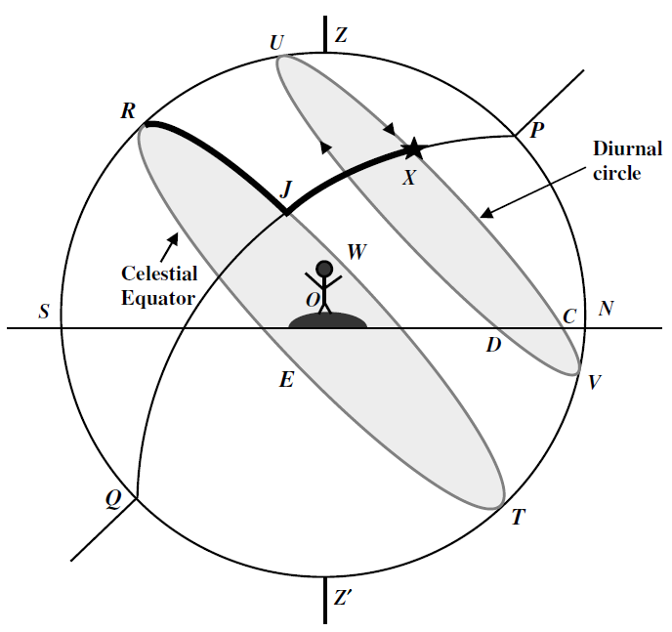

Slide 13
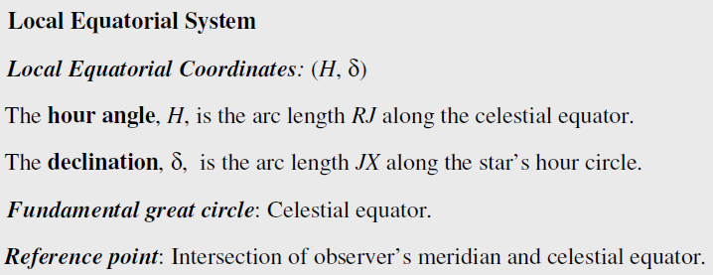

Slide 14

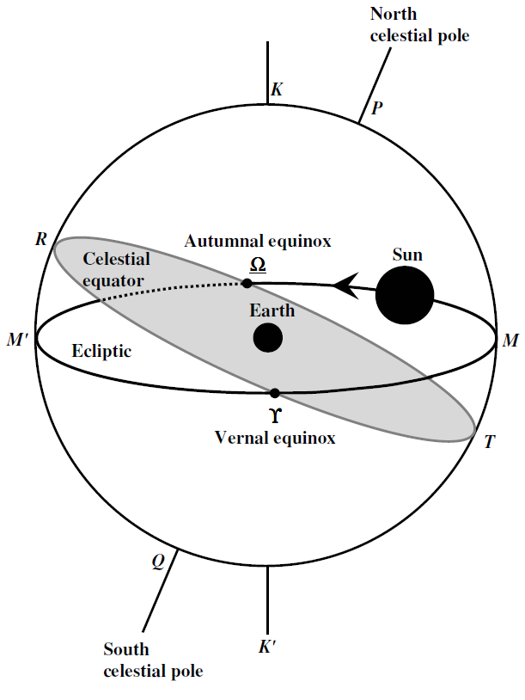

Slide 15
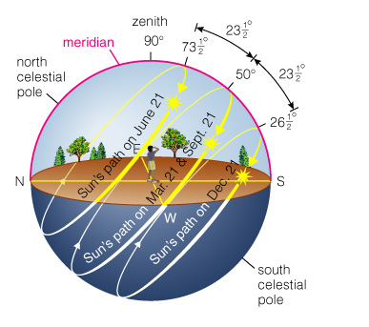

Slide 16
More on Sun’s apparent motion as seen from Earth
The ecliptic
Because of the tilt of the Earth's rotation axis, over the year the Sun seems to travel on a path on the celestial sphere which is tilted 23.5° with respect to the celestial equator.
This path is called the ecliptic.

Slide 17
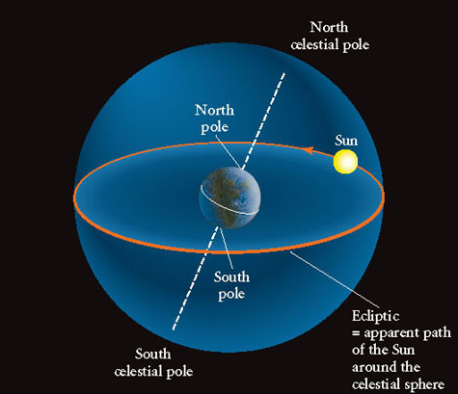
It appears to us that the Sun travels around the celestial sphere once a year. A parallax effect: as we orbit Sun, it is projected against different stars. After 1 year, it returns to same position relative to the stars.

Slide 18
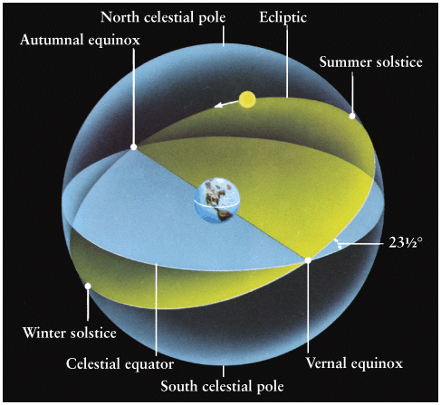
Solstices and Equinoxes
In March, the Sun moves northward across the celestial equator - at the vernal equinox (recall this defines 0^{h} RA).
In September, the Sun moves southward across the celestial equator - at the autumnal equinox. Day and night have equal length on equinoxes.
The summer and winter solstices occur at the northernmost and southernmost points of the ecliptic.
Path of the Sun over the year
Notes:
Why is the vernal and autumnal equinoxes unfair terminology for people living in the southern hemisphere? "Sol sistere" = sun standstill.

Slide 19
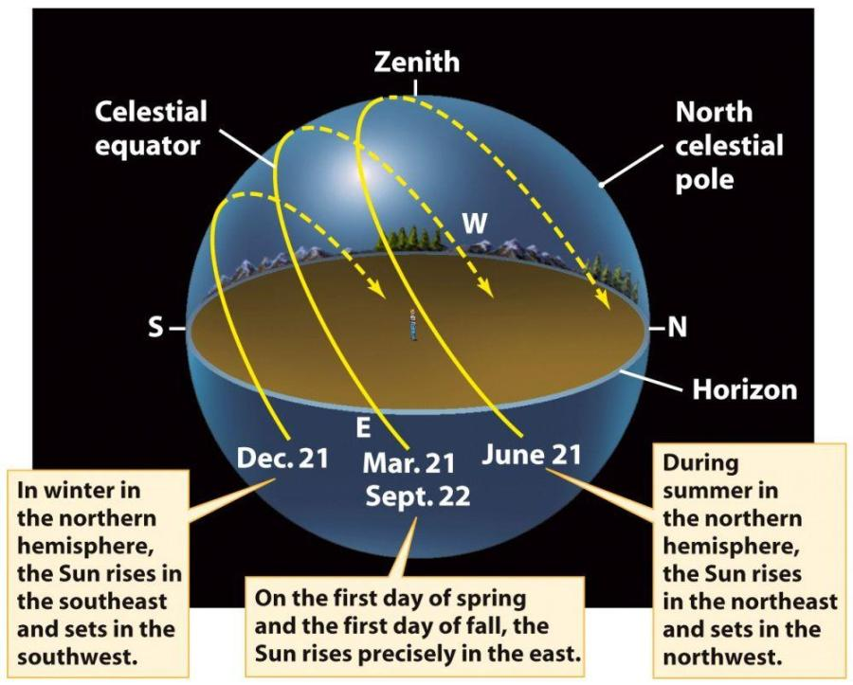
Apparent path of the Sun over the day at different times of year

Slide 20
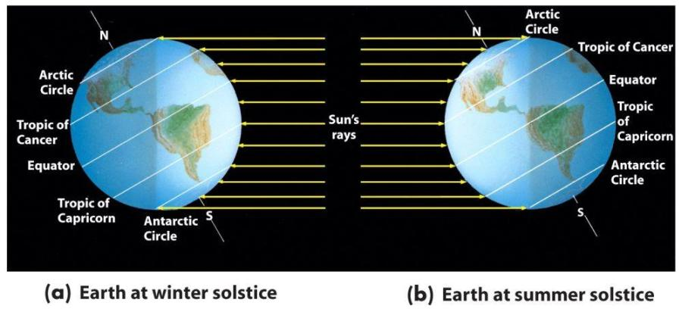
Change in length of day at high latitudes is quite dramatic! Above Arctic Circle, Sun never sets for some days in summer.
Notes:
Defines the Arctic and Antarctic circle!

Slide 21
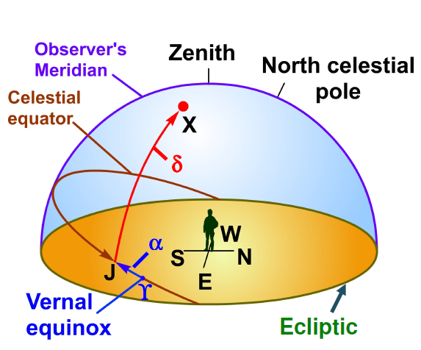

Slide 22
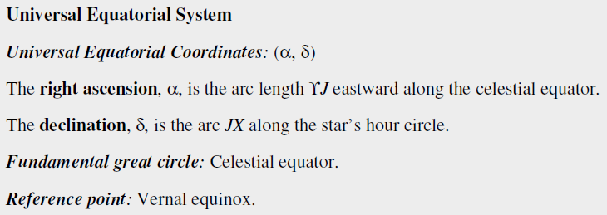
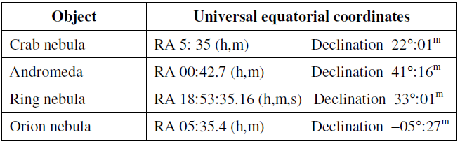

Slide 23
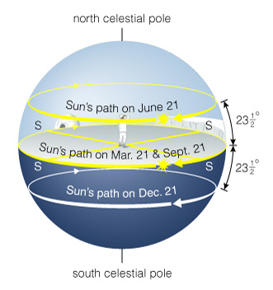
Sun’s Path at North Pole
Sun remains above horizon from spring equinox to fall equinox
Altitude barely changes during a day

Slide 24
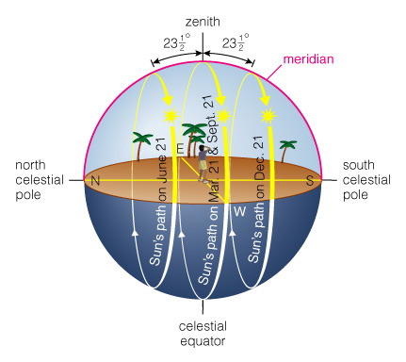
Sun’s Path at Equator
Sun rises straight up and sets straight down
North of celestial equator during spring and summer
South of celestial equator during winter and fall

Slide 25
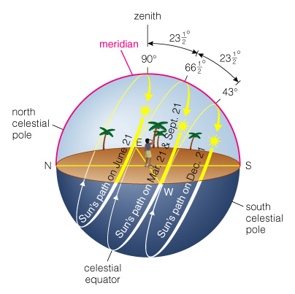
Sun’s Path at Tropic of Cancer
Sun passes through zenith at noon on summer solstice

Slide 26
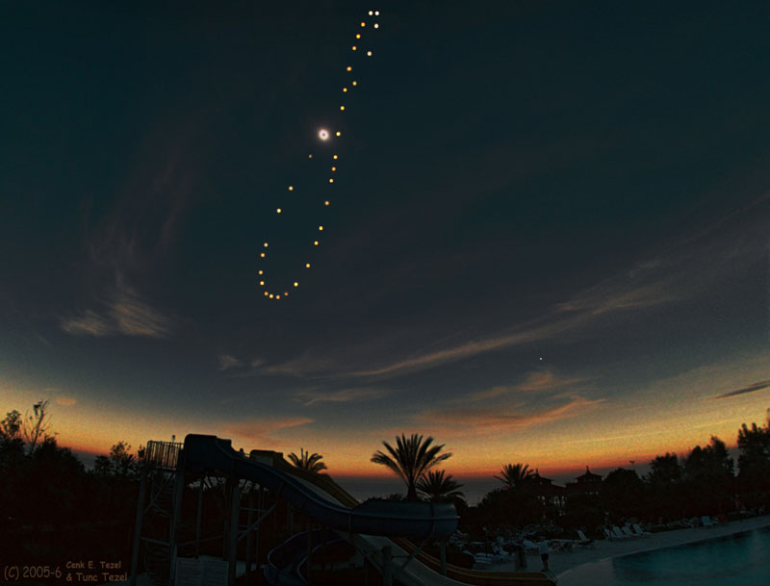
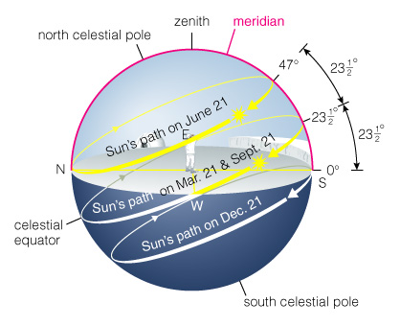
Sun’s Path at Arctic Circle
Sun grazes horizon at midnight on summer solstice

Slide 27
Solar vs. Sidereal Time
In "real life", we use the Sun to tell time – it defines the length of a day.
A solar day is the time interval between successive meridian crossings of the Sun – noon-to-noon.
This is different from time kept by the stars, known as sidereal time.
A sidereal day is the time for Earth to spin 360° on its axis. Why is this different?

Slide 28
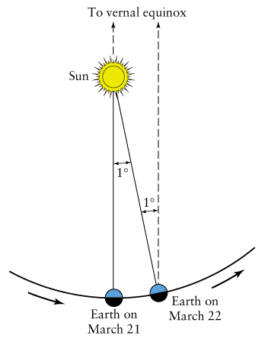
The Earth is not only spinning but also orbiting around the Sun.
The Earth must turn a bit more than 360° in a solar day because it’s moved in its orbit a little while spinning.
The difference is about 3.9 minutes.
Solar day: 24 hours.
Sidereal day : 23 hours, 56 minutes, 4.091 seconds.
After 1 year, Sun returns to same position on celestial sphere. A year has one fewer sidereal days in it.
Observatories use sidereal clocks!

Slide 29
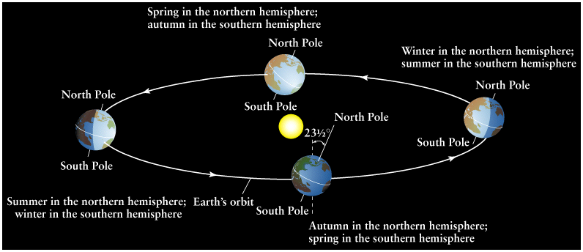
Note how the Sun moves across the celestial sphere as the year goes on. It’s fixed to the stars, not the Sun.
Vernal equinox is the point on the celestial equator the Sun crosses on its march north - the start of spring in the northern hemisphere (cf. Greenwich 0° longitude).
Vernal equinox
So 0° of RA is defined as location of Sun at midday on the Vernal equinox, and location overhead at midnight on the autumnal equinox. Note Sun is at Dec=0° at these times too.

Slide 30
Declination (Dec) is measured in degrees, arcminutes, and arcseconds.
Right ascension (RA) is measured in units of time: hours, minutes, and seconds.
This stresses that the sky is rotating over us as time passes, making changes in the sky more meaningful to observers.

Slide 31
Caution: a star’s RA and Dec change slowly with time due to "precession" of the Earth.
Celestial coordinates are exactly right for only one instant in time.

Slide 32
Precession
The direction where the Earth’s poles point isn’t always the same – the Earth is wobbling like a top.
Why? Due to the gravitational pull of the Sun and the Moon on the non-spherical Earth.
The Earth has an equatorial bulge – It is a little fatter at the equator than at the poles. (Diameter difference is 43 km out of 12,756 km)

Slide 33
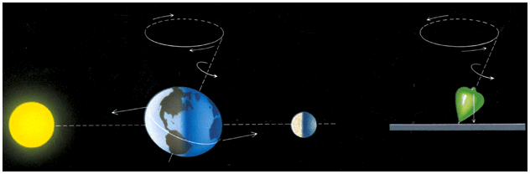
The gravitational pull of Sun and Moon on Earth’s equatorial bulge causes the poles to trace out a circle, like a spinning, wobbling top. This is "precession".

Slide 34
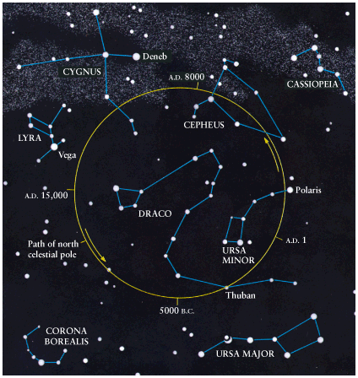
So the north celestial pole slowly traces out a circle among the northern constellations. It takes 26,000 years to trace out one circle.
Polaris won’t always be our "pole star"! Most of the time we don’t have one!
Thus RA and Dec coordinates, which are tied to the positions of the celestial poles and celestial equator, change slowly with time.

Slide 35
The Zodiac
As the Sun moves along the Ecliptic it passes through 12 constellations known as the Zodiac.

Slide 36
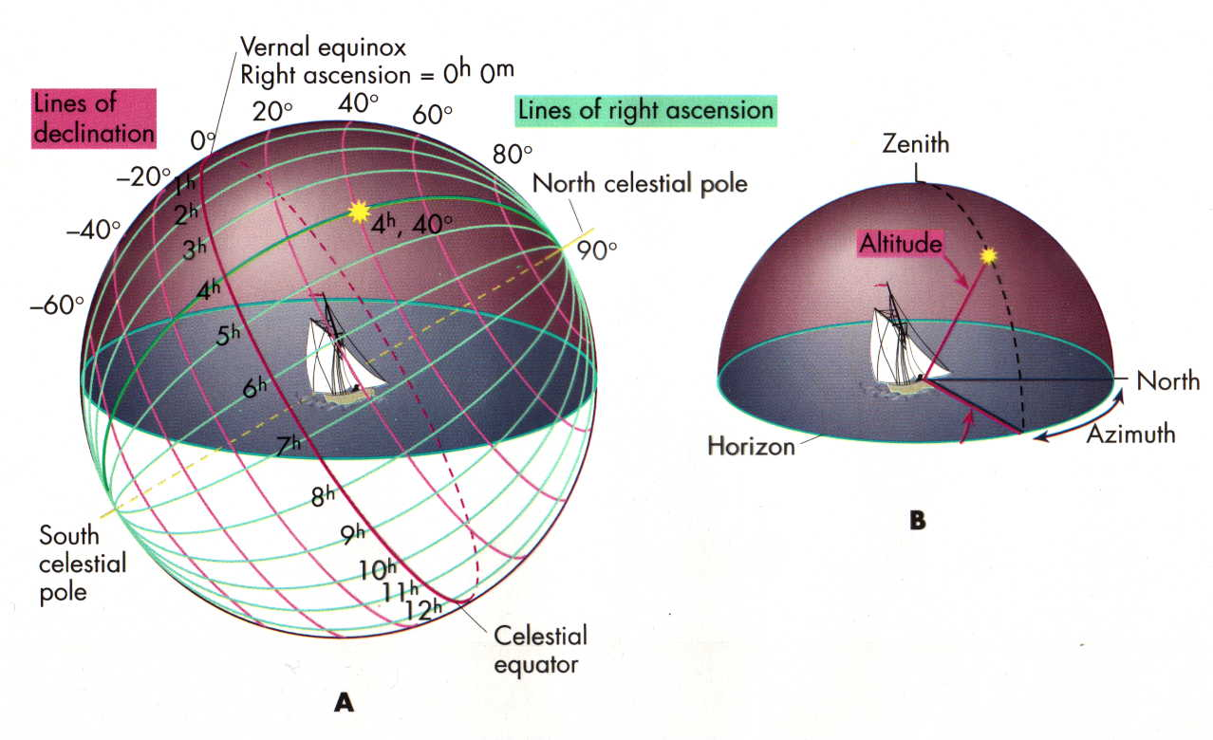
Celestial Coordinates
To “map” a given point in the sky, you can specify how high it is, and in what direction (altitude and azimuth). Or you can project latitude (declination) and longitude into the sky, but since the Earth rotates, we must use “right ascension” which is fixed on the stars.

Slide 37
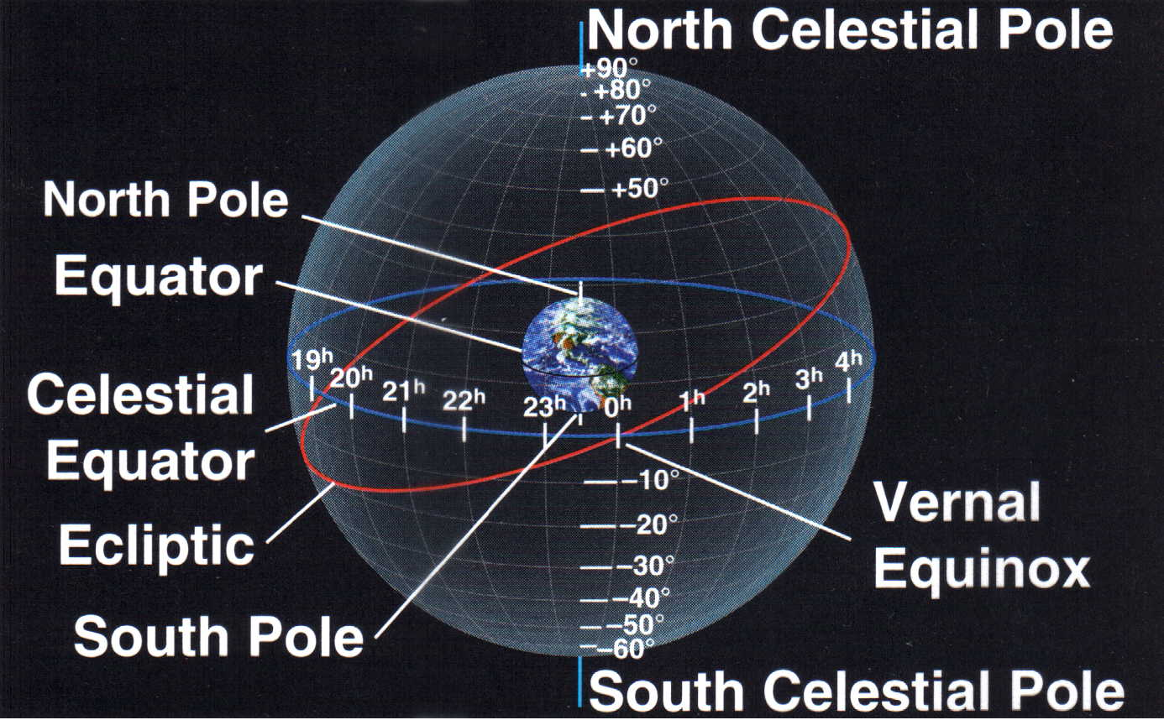
The Ecliptic Plane
The projection of the Sun’s path on the celestial sphere, or equivalently the projection of the plane of the Earth’s orbit, is called the “ecliptic”. It has a 23 degree tilt to the equator.

Slide 38
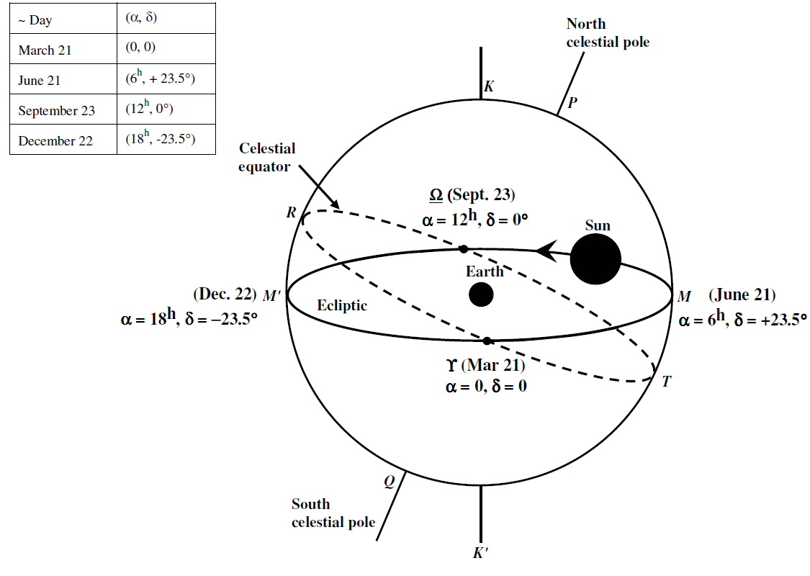

Slide 39
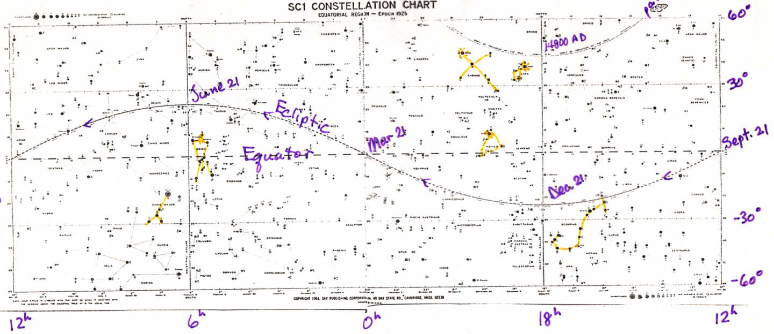
Chart of the Sky
Note how the Sun appears to go North and South as the year progresses. The zero point of Right Ascencsion occurs at the Spring crossing of the Equator (vernal equinox). The solstices occur at the maximum N/S excursions.

Slide 40
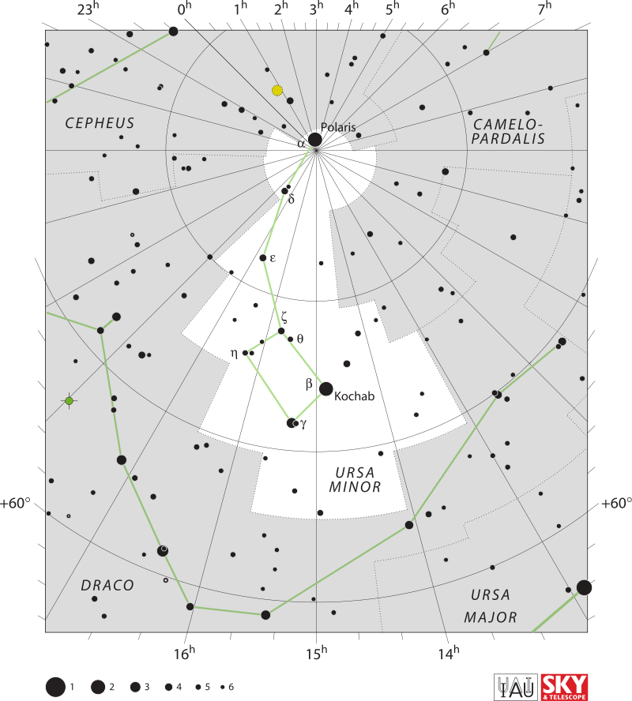

Slide 41
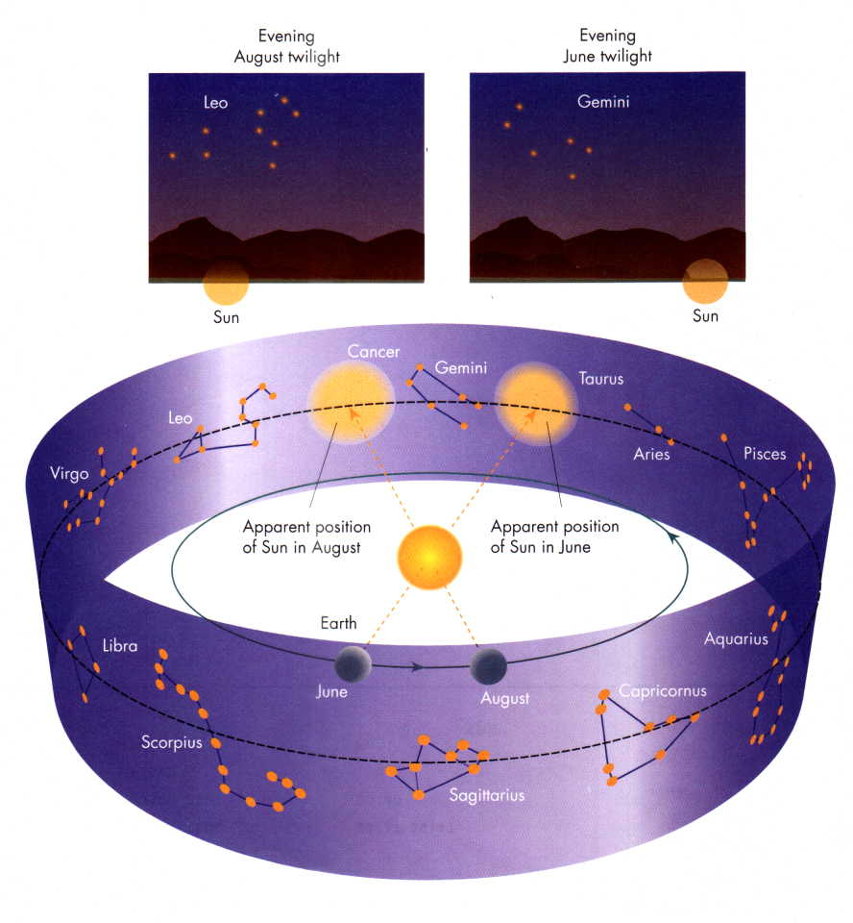
The Seasonal Stars
Constellations along the ecliptic are called the “Zodiac”. The visible ones change through the year because the Earth orbits the Sun. The constellations themselves are arbitrary groupings of stars in the sky.
The stars up at night in the summer are up during the daytime in the winter.

Slide 42
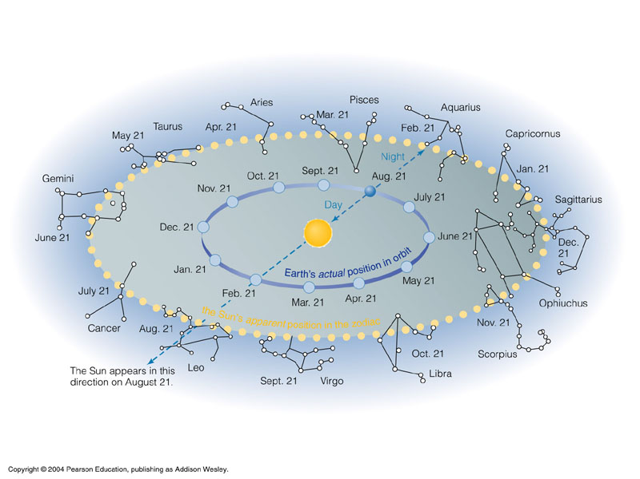

Slide 43
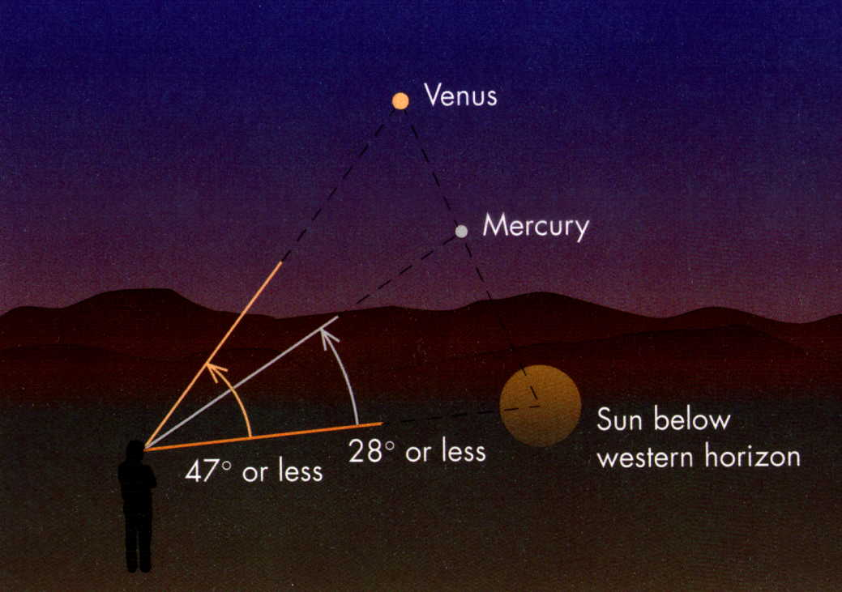
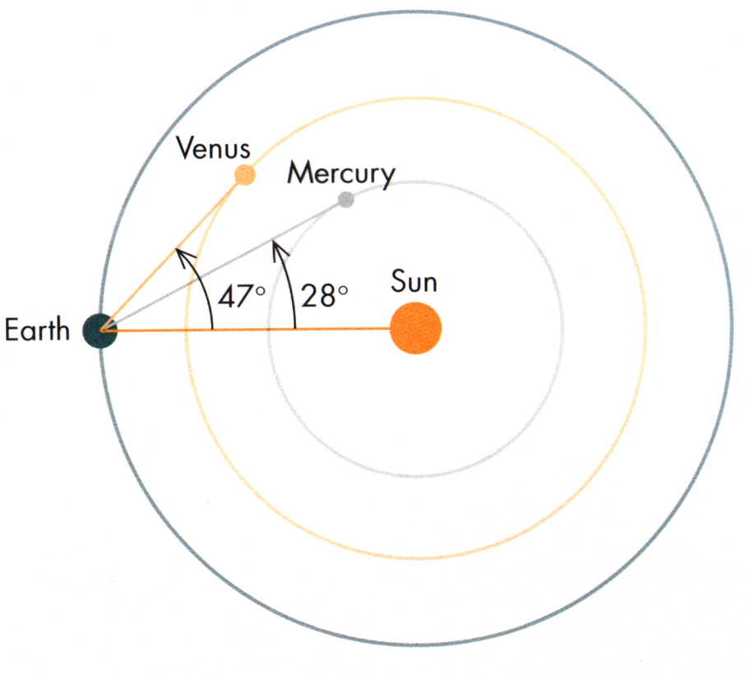
Morning and Evening “Stars”
We see Mercury and Venus follow the Sun around in the sky. They may go down after, or come up before it. If they go down after, we see them in the evening.
This is because they have orbits inward of ours. That means they can only be seen to a certain maximum angle away from the Sun.

Slide 44
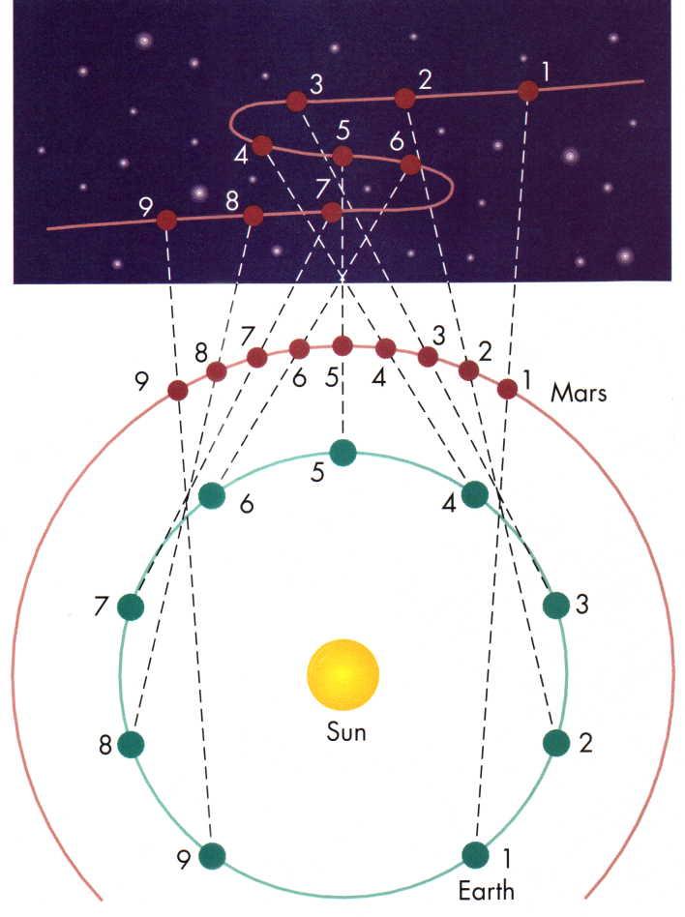
Retrograde Motion
The outer planets appear to make strange reversals in their motion against the stars. This is due to the fact that the Earth moves around the Sun faster than they do, causing us to overtake them periodically, during which time they appear to move “backwards” in the sky. This caused a lot of headaches for those trying to explain the apparent motion of the planets. The “S” shape is due to the fact that the orbital planes aren’t quite aligned.

Slide 45
UNIT 4: Physical Principles
1. Virial Theorem

Slide 46
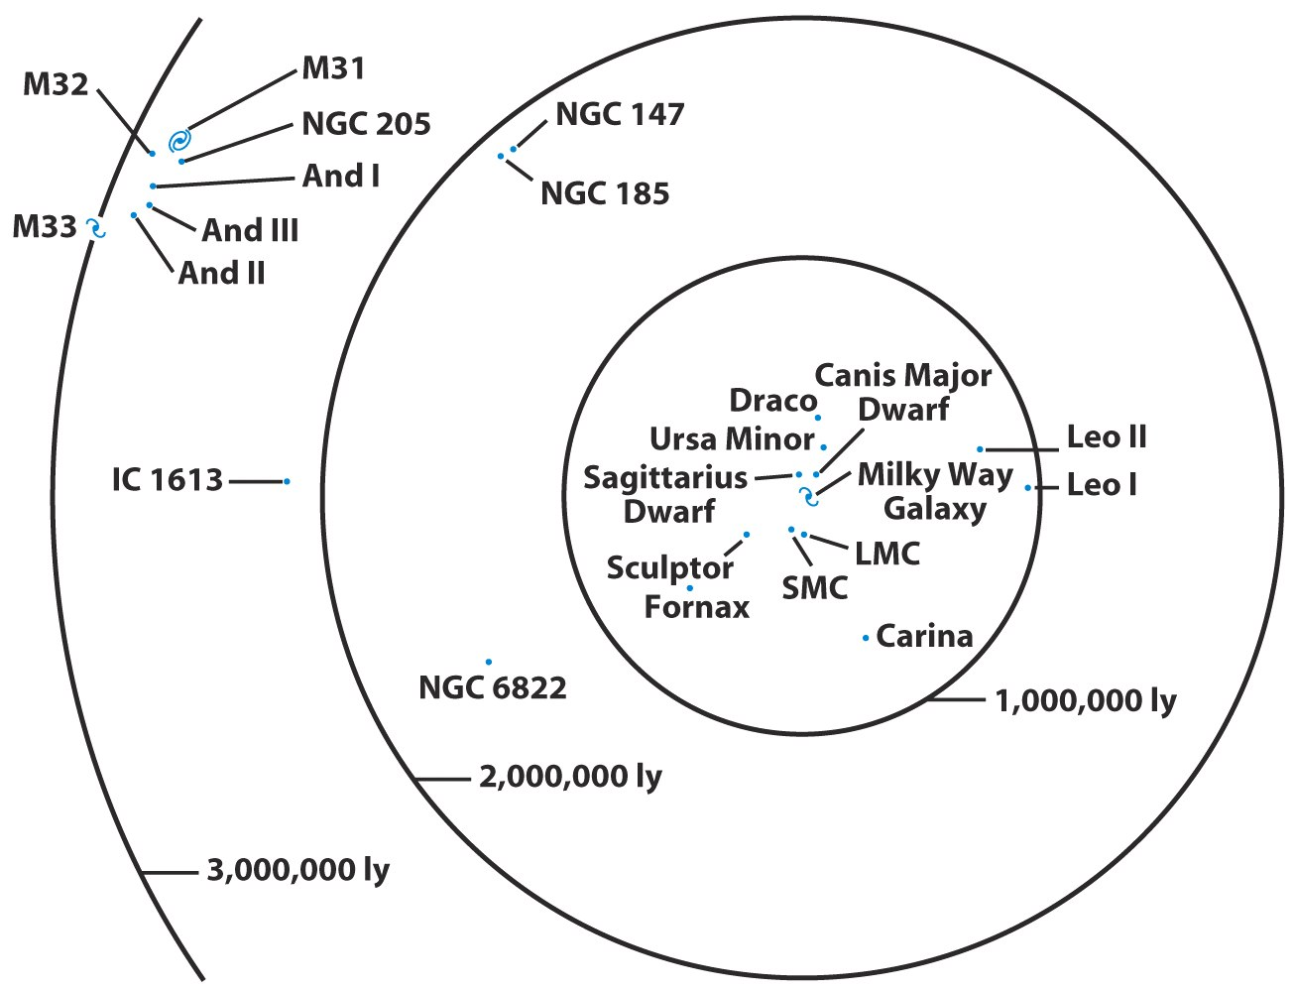
Our Galaxy is a member of a small cluster called the Local Group

Slide 47
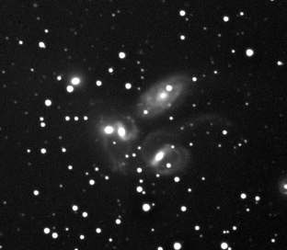
Stephane’s Quintet

Slide 48
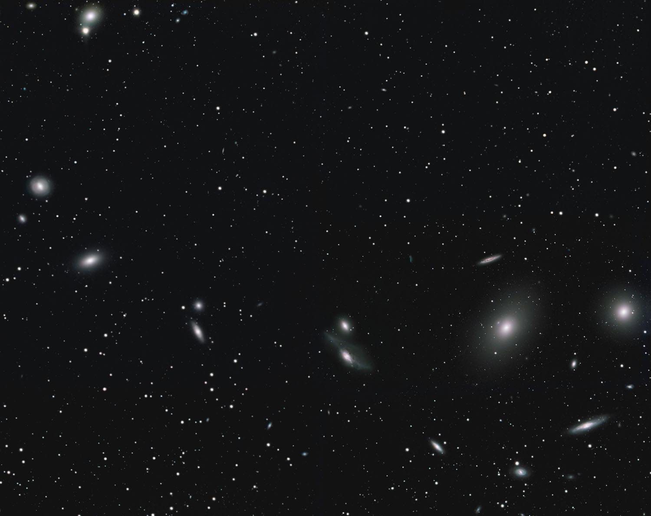
Virgo cluster

Slide 49
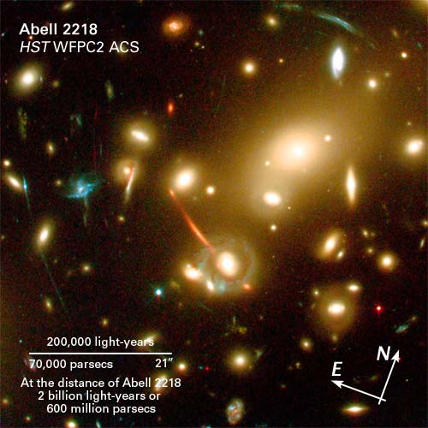
Abell 2218

Slide 50
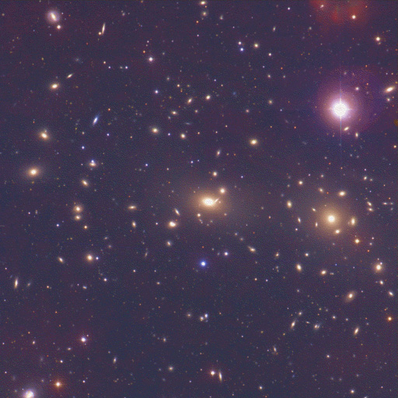
Coma cluster

Slide 51
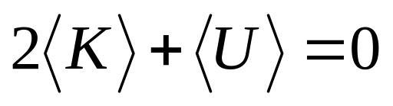
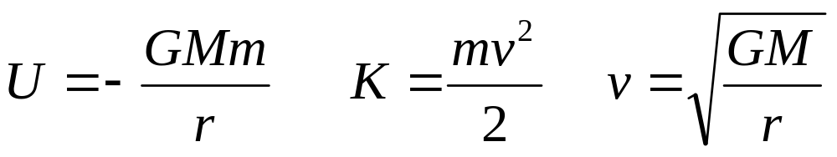
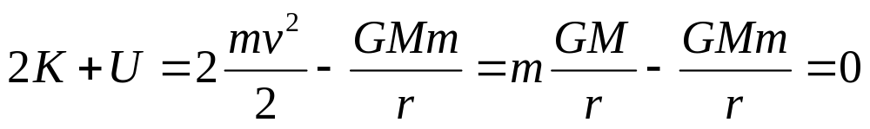
Virial Theorem
For gravitationally bound system,
Where K is kinetic energy and U is potential
Check for planet orbiting star

Slide 52
Check for the Sun-Earth System
M (Sun) = 2 * 10³⁰ kg
M (Earth) = 6 * 10²⁴ kg
R = 150 * 10⁶ km
G = 6.7 * 10⁻¹¹ m³ kg⁻¹ s⁻²
V = 30 km s⁻¹

Slide 53
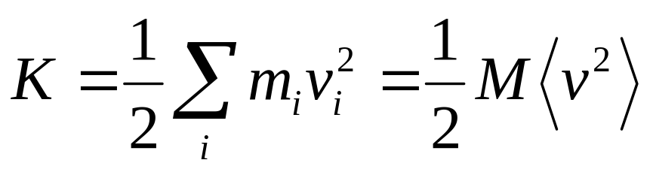
For Cluster
Kinetic energy
Where m_{i}, v_{i} are mass, velocity of each galaxy
and M, <v²> are total mass, average velocity
How to find <v²>?
Can measure only line of sight velocity
Note <v²> = <v_{x}² + v_{y}² + v_{z}²> = 3 <v_{z}²> = 3σ²
where σ is the “velocity dispersion”

Slide 54
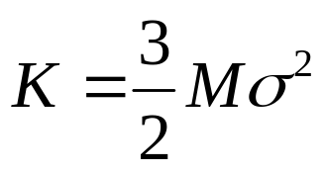


For Cluster
Kinetic energy
Potential energy
where r_{h} = “half-light radius”
Use virial theorem 2K+U = 0 to find

Slide 55
For Coma Cluster
r_{h} = 1.5 Mpc
σ = 880 km/s
Calculate M = 2×10¹⁵ M
Note that this includes dark matter
Mass to light ratio of cluster is 250 M/L

Slide 56

Coma cluster in X-rays

Slide 57
Coma cluster
X-ray emitting gas is at 100,000,000 K.
The total X-ray luminosity is more than the luminosity of 100 billion Suns.
From this, the amount of X-ray emitting gas can be calculated to be 2×10¹⁴ M
The mass of X-ray emitting gas is greater than the mass in all the stars in all the galaxies in the cluster and about 10% of the total mass.

Slide 58

Gravitational lens

Slide 59
Gravitational lenses
By measuring multiple images of one source, we can figure out the total mass in the lens. This provides an independent confirmation of dark matter.
A lense can act as a huge telescope. The deepest images of the most distant galaxies are obtained with clusters acting as gravitational lenses.

Slide 60

The red Galaxy is 13 billion light years away.
We are seeing it 750 million years after the Big Bang.

